Slide 1

$ ./bank-of-cli
Bank of CLI
A terminal banking application with a persistent ledger, atomic transfers, and a layered architecture.
By Ethan Duarte
Notes:
Open with the one-liner: this is a full banking ledger that runs entirely in the terminal. Keep the intro to about twenty seconds.

Slide 2
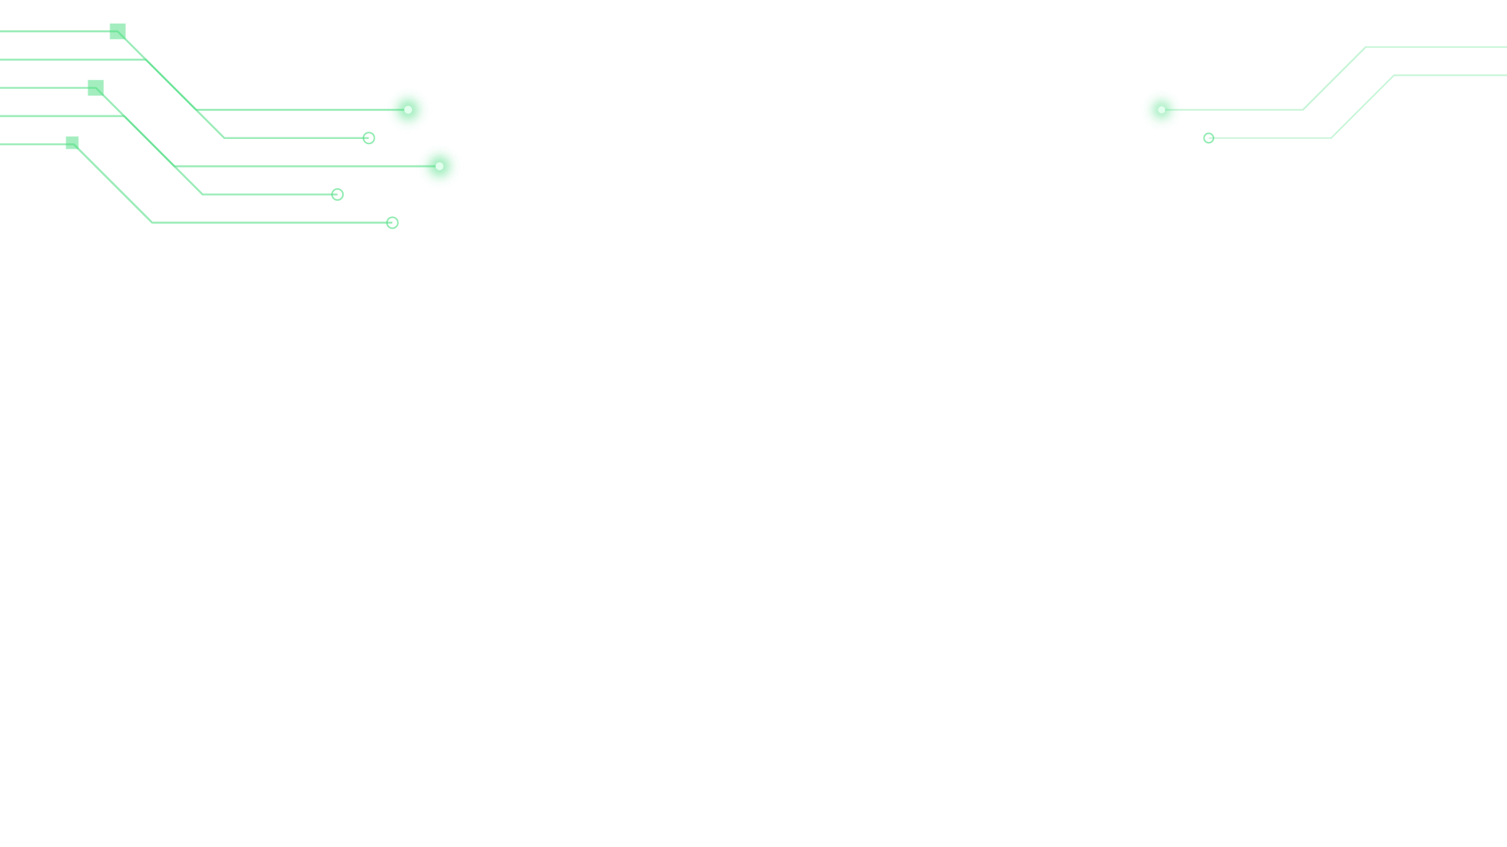
What it does
01
02
03
Secure access
Transaction engine
Audit trail
Register and log in with a generated account ID and a 4-digit PIN.
Deposit, withdraw, and transfer with overdraft protection.
Every movement of money is recorded and queryable per account.
Everything runs in the terminal, backed by a relational database
Notes:
Thirty seconds. Name the three feature groups, read the closing line, move on. Do not linger here — the demo is what sells it.

Slide 3
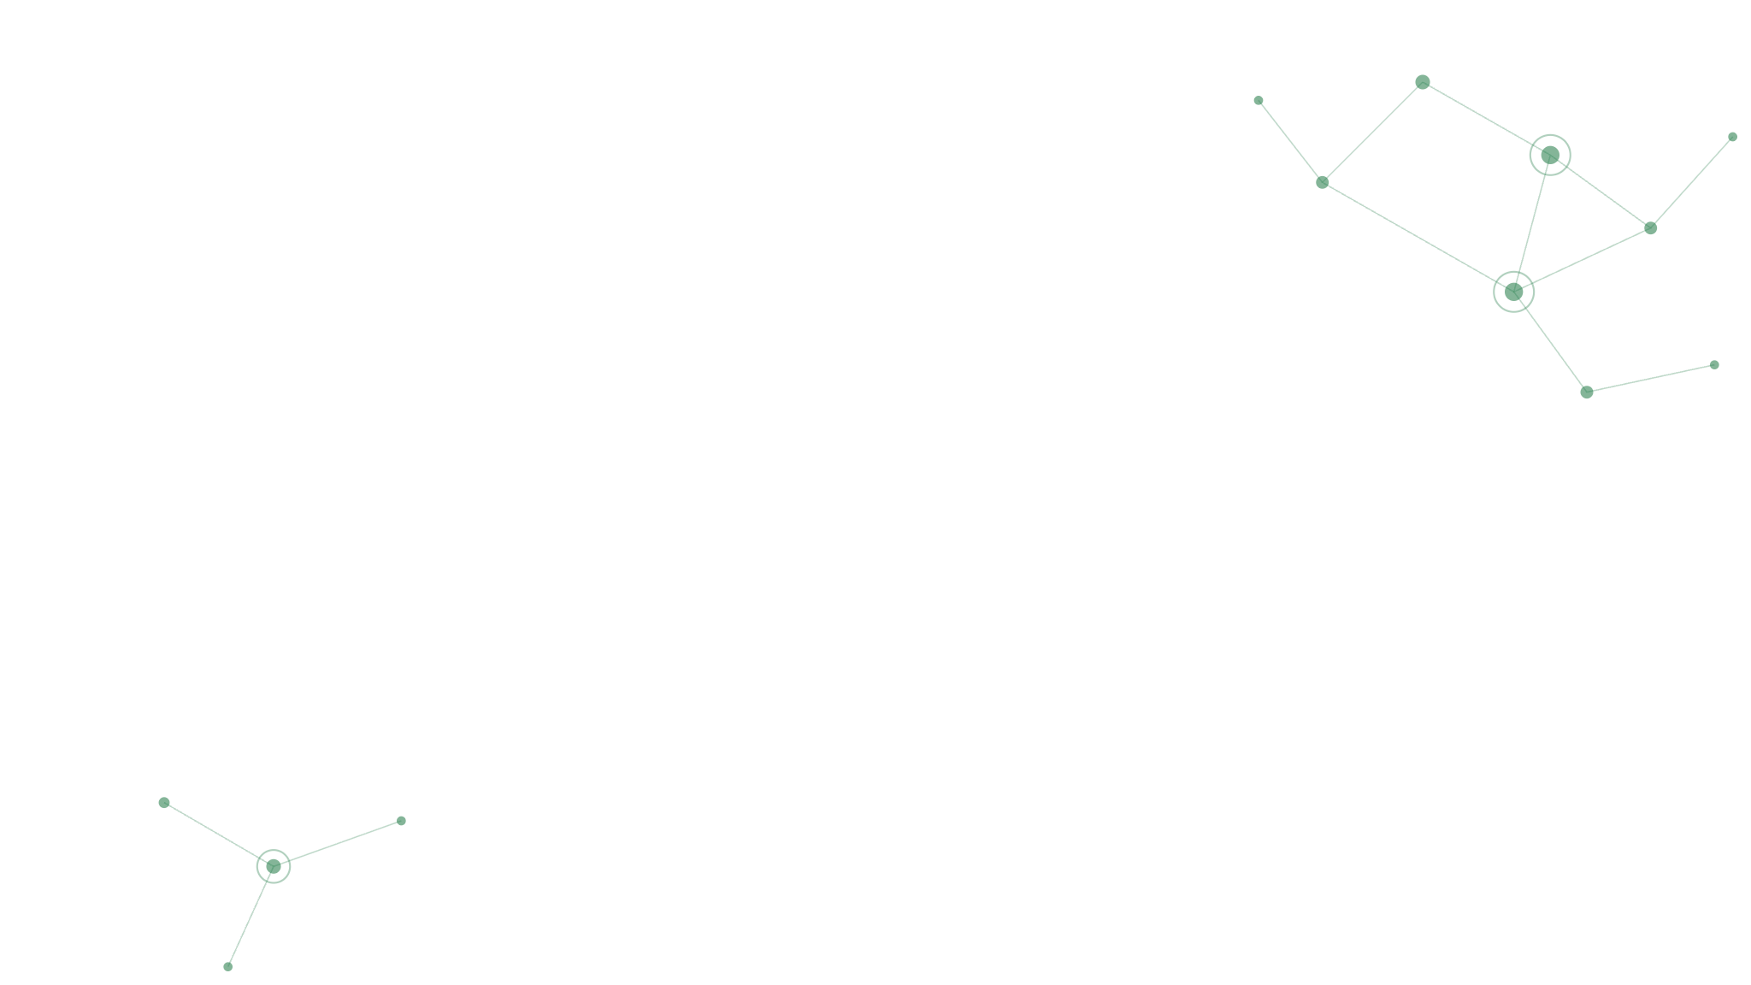
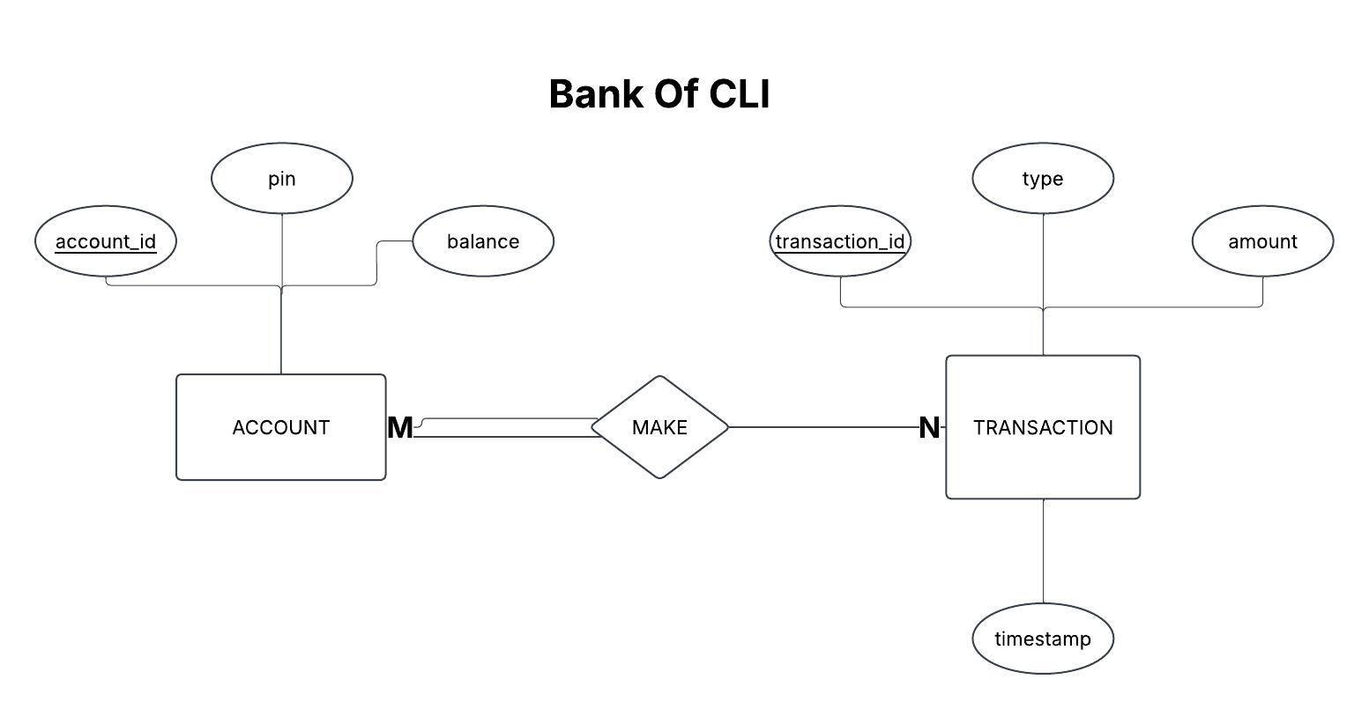
The data model
One account makes many transactions. A transfer writes two rows: (Row 1 - Sender, Row 2 - Receiver) — linked by related_account_id.
Notes:
One minute. Point out that deleting an account cascades to its transactions, and that related_account_id is set to null rather than cascading so the other party keeps their history.

Slide 4

The 4 Layers
CALLS
DOWN
api
Terminal I/O, menus, and input validation. Talks only to the service layer.
service
Banking rules: PIN format, positive amounts, sufficient funds, no self-transfer.
persistence
JDBC, SQL, and transaction control. Maps result set rows to Java objects.
domain
Account and Transaction. Every layer depends on it; it depends on nothing.
This is the DAO pattern: all data access sits behind a BankDAO interface, so the service layer never touches SQL.
Notes:
Two minutes. Trace the arrow downward as you name each layer, then stop at domain and say it is the exception — the dashed box means everything depends on it and it depends on nothing. The why for DAO: the service layer states banking rules, the DAO states how to reach the data, and neither knows the other's business. BankServiceImpl takes the BankDAO interface through its constructor and Main is the only class that names the implementation. If they ask how DAO differs from Repository: DAO abstracts data access, Repository abstracts a collection of domain objects.

Slide 5
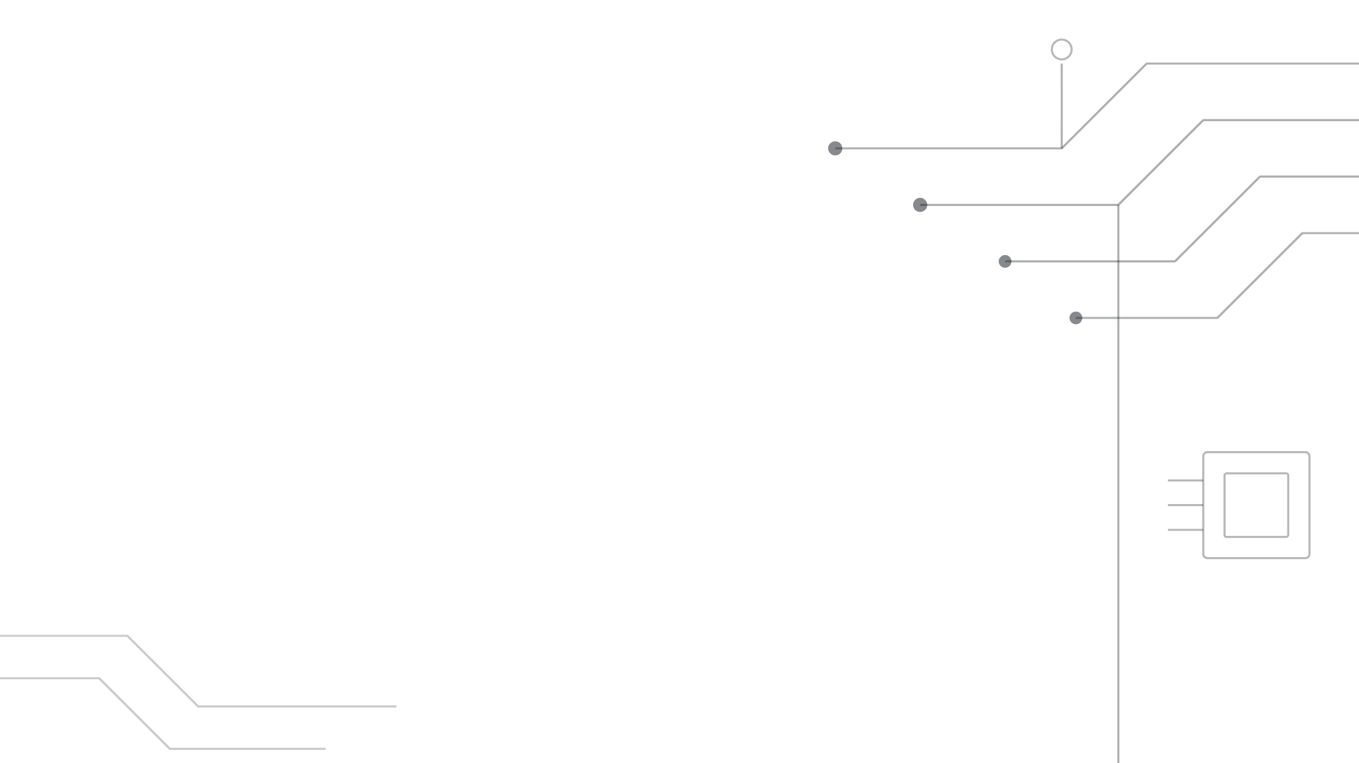
LIVE DEMO
Bank Of CLI Demo
signup → login → deposit → withdraw → transfer → transactions → update → delete
Notes:
Four to five minutes — this carries the validation and error-handling story, so narrate as you go. Run the demo in this order: try a command while logged out (the guard says "Please log in first"), log in with a wrong PIN, sign up, log in, then try to sign up again while logged in. Deposit, transfer, and pull up transactions. End with an overdraft attempt. As failures appear, name the layer catching each one: the API checks shape, the service checks banking rules, the database checks the balance at write time. Say that user mistakes throw IllegalArgumentException and system failures throw IllegalStateException, and the REPL catches them separately so nobody ever sees a stack trace. Then circle the package folders with your mouse and tie them back to the layers slide, and show the Logback file filling up.

Slide 6

Where ACID Lives
Atomicity
All four statements in a transfer land together or not at all : setAutoCommit(false), commit(), rollback().
Consistency
The constraints defined when the entities were created hold before and after such as NOT NULL, foreign keys, NUMERIC(12,2), and AND balance >= ?.
Isolation
Concurrent transfers don't see each other's half-finished work. Postgres by default is READ COMMITTED.
Durability
Once committed, it survives a crash. Handled by the Postgres write-ahead log.
Notes:
Forty-five seconds. The honest framing is the point: atomicity is the one you actively coded, consistency comes from constraints you defined, and isolation and durability come free from Postgres. Do not claim you implemented ACID. If they push on isolation, say you did not override the default and READ COMMITTED was sufficient here.

Slide 7
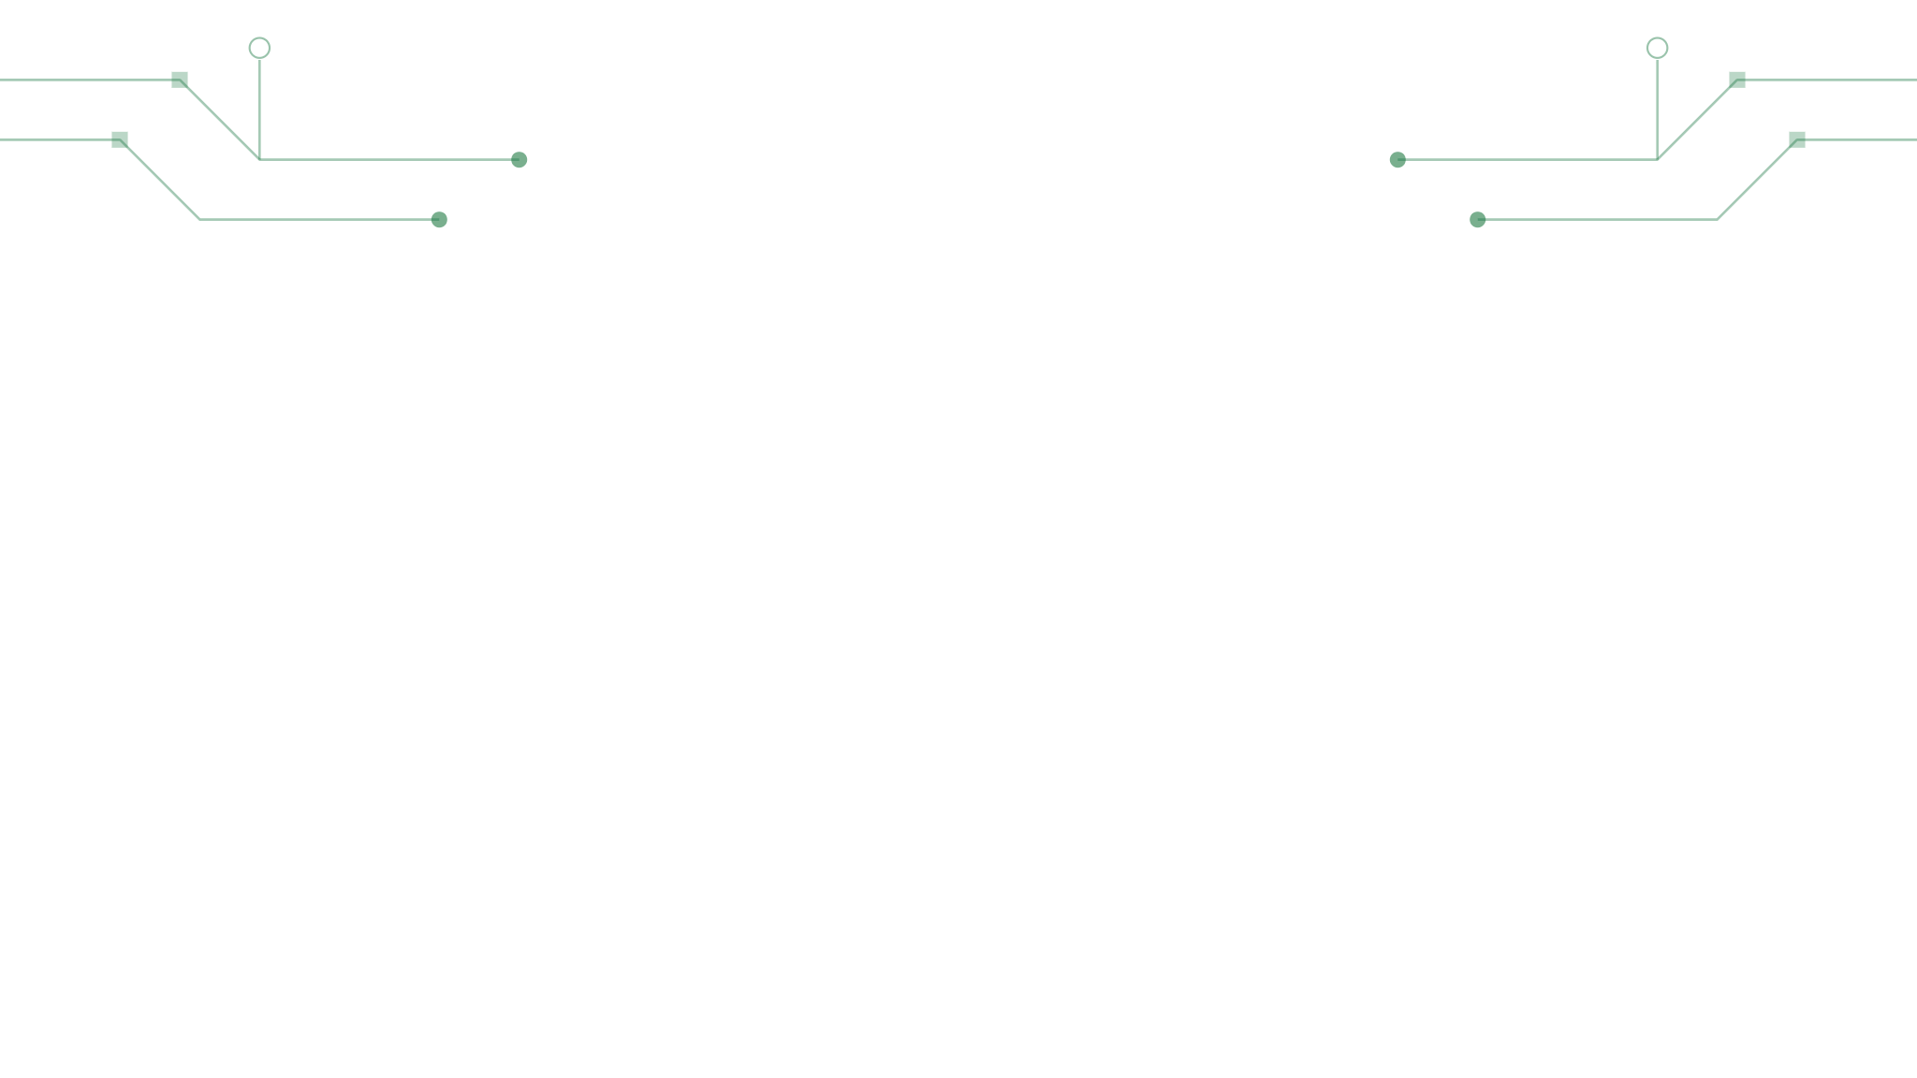
Testing
NEGATIVE TEST
POSITIVE TEST
A self-transfer must be rejected
A valid transfer moves the money
assertThrows proves the service throws when the source and destination are the same account — and it passes a null DAO, so the rule is enforced before the database is ever touched.
Two accounts, one transfer of 200, then assertEquals on both balances — 300 out of one, 200 into the other.
Both follow Arrange, Act, Assert. The positive test still hits the real database, because BankServiceImpl takes the DAO as an interface.
JUnit 5 · BankServiceImplTest
Notes:
Thirty seconds. Name the two kinds: negative proves invalid input is rejected, positive proves valid input works. The detail worth saying is the null DAO in the negative test — it can be null because the self-transfer check runs in the service layer before any database call, which proves the rule lives where you said it does. Be honest that the positive test hits the real database and that stubbing is the next step.

Slide 8
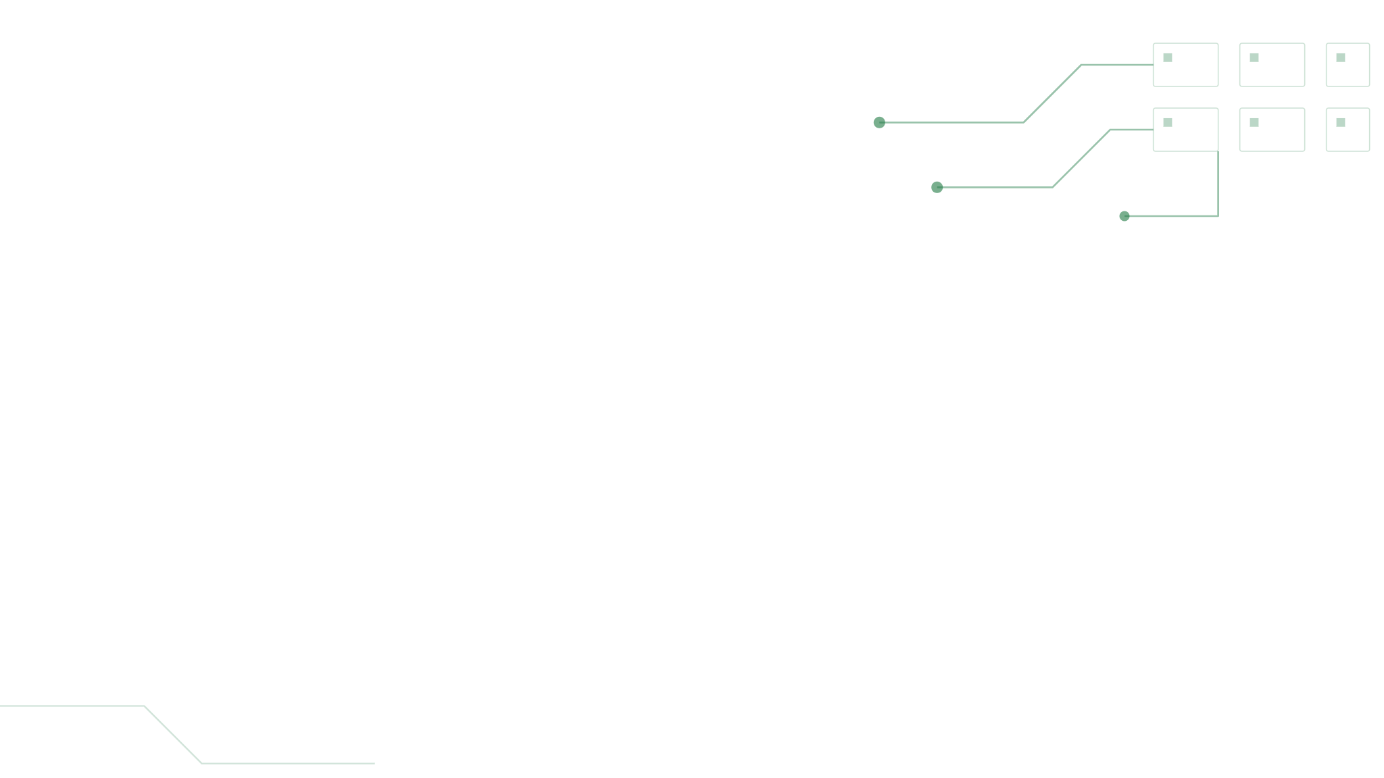
Technologies used
Java 17
The language, with switch expressions, lambdas, and try-with-resources.
Maven
Build tool and dependency management via the POM.
PostgreSQL
The relational database holding accounts and the transaction ledger.
JDBC
The Java API connecting the application to that database.
SLF4J + Logback
The logging interface I code against, and the implementation that writes a rolling daily file.
JUnit 5
Unit testing for the service layer.
Version controlled with Git and GitHub
Notes:
Forty-five seconds. Read the left column and give one clause each; do not read every description aloud. The one to say carefully is SLF4J plus Logback — SLF4J is the interface you code against and Logback is the implementation underneath. It is not Log4j.

Slide 9

What I'd do next
BigDecimal
Balances are NUMERIC in Postgres but double in Java. Floating point has no place in money.
Hashed PINs
PINs are stored in plaintext today. BCrypt with a per-account salt is the fix.
Stubbed tests
Swap the real DAO for a stub so service tests run without a live database.
github.com/aduart03/BANK-OF-CLI
Notes:
Thirty seconds. Naming these three limitations yourself is stronger than having someone find them for you — it shows you know what production-grade would actually require. Then move to the Q and A slide.

Slide 10
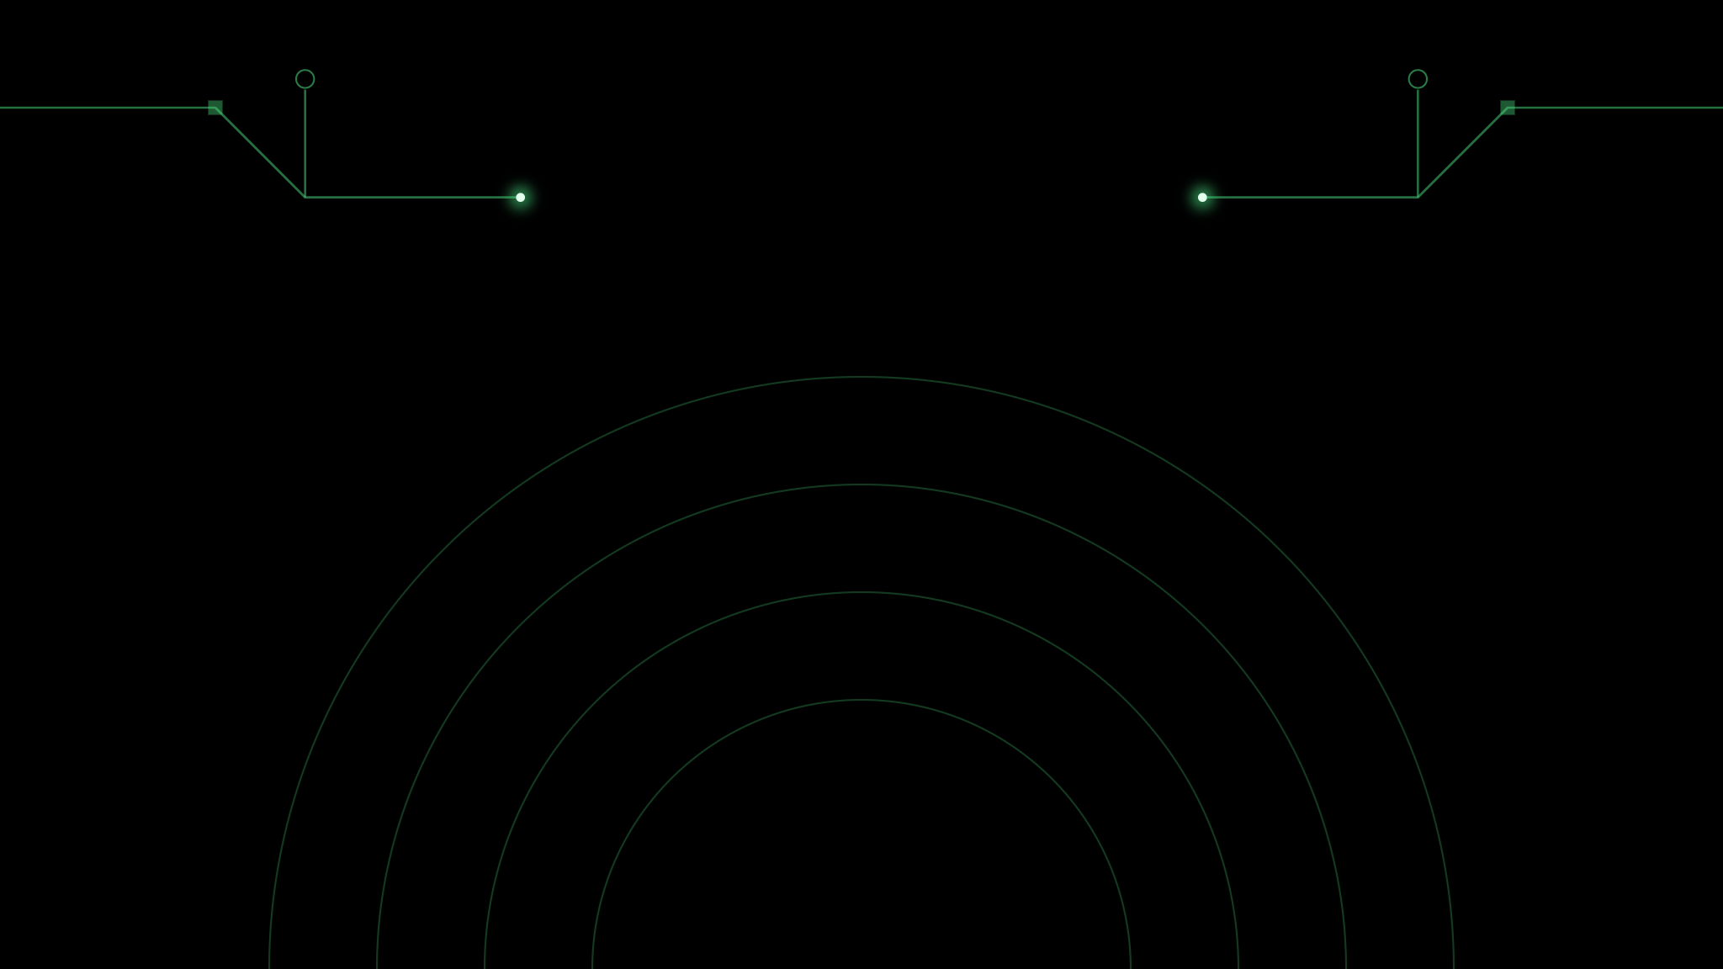
Q & A
github.com/aduart03/BANK-OF-CLI
Notes:
Leave this up. Questions to have an answer ready for: why DAO and not Repository; what setAutoCommit(false) actually does; why PreparedStatement over Statement; what happens if two transfers hit the same account at once; why double instead of BigDecimal (own it — it is on the previous slide); how many tests you wrote (two, both on transfer, and stubbing the DAO is the next step). If you do not know something, say so and say how you would find out.

